Slide 1
Job control
Dr. Jitendra Nasriwala

Slide 2
Job control
UNIX is a multitasking operating system.
Recall : multitasking
One of the important features of shell is job control.

Slide 3
A Job
A job is a command or set of commands entered on one command line.
For example:
ls
who | grep ‘^a’ > userlist.txt
sort friendlist.txt

Slide 4
Job Control
Unix is Multitasking.
One can run more than one job a time.
As soon as you run command, the standard input and output are locked.
To run multiple job UNIX defines two types of jobs: foreground and background.

Slide 5
Foreground Job
A foreground job is any job run under the active supervision of the user.
It started by the user and may interact with the user through standard input and output.
While it is running, no other jobs may be started.
To start foreground job, enter command and press return key.
Only one job can be in foreground at any time.

Slide 6
Backgound Job
Some jobs takes more than usual.
That kind of job can be run in background.
Background job can share standard input and output with foreground job, but it can create confusion.
To run job in background add & at the end of command without space
longjob.sh&
sort frienlist.txt > sortedlist.txt&

Slide 7
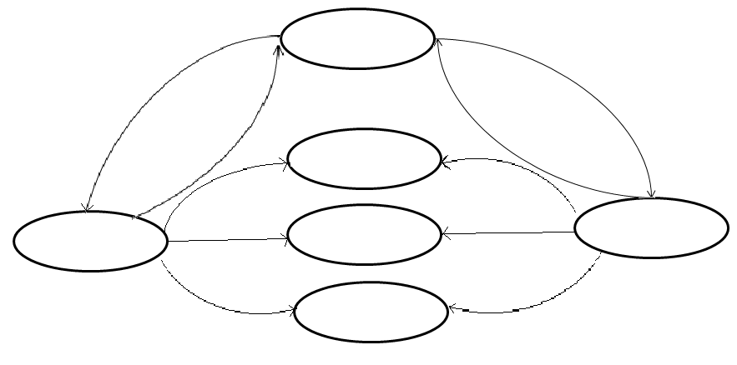
Stopped
(Suspended)
bg
fg
ctrl+Z
stop
Exit
Done
Running
background
Running
Foreground
kill
Terminated
ctl+c
Job control

Slide 8
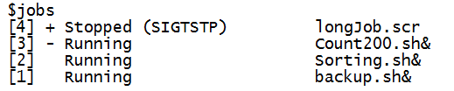
jobs command
Jobs command used to list current jobs and its status
Job number
Job status
Job
Currency flag

Slide 9
Switching jobs
Foreground to foreground
Foreground to Background
Background to Foreground
Background to Background

Slide 10
fg and bg command
Syntax
fg [jobnumber]
Default applied to most recent job, currency flag +
fg %3 #applied to job number 3
fg %+ or fg %% or fg #applied to most recent job
fg %- #applied to older job having currency sign -

Slide 11
fg and bg command
Syntax
bg [jobnumber]
Default applied to most recent job, currency flag +
bg %3 #applied to job number 3
bg %+ or fg %% or fg #applied to most recent job
bg %- #applied to older job having currency sign -

Slide 12
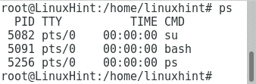
ps command
ps command list processes and their status

